Slide 1
WEB Technologies (CS-566)
LECTURE # 2 & 3 – Web Development & HTML Introduction

Slide 2
Outline
Web Development
Introduction to HTML
Basic Structure of a HTML page
Tags & Attributes
Paragraphs in HTML
Text formatting Tags in HTML
Environment Setting

Slide 3
Web Development

Slide 4
Web Development
Web development refers to the building, creating, and maintaining of websites. It is the creation of an application that works over the internet i.e. websites.
It includes aspects such as
Web Design
Web Publishing
Web Programming
Database Management

Slide 5
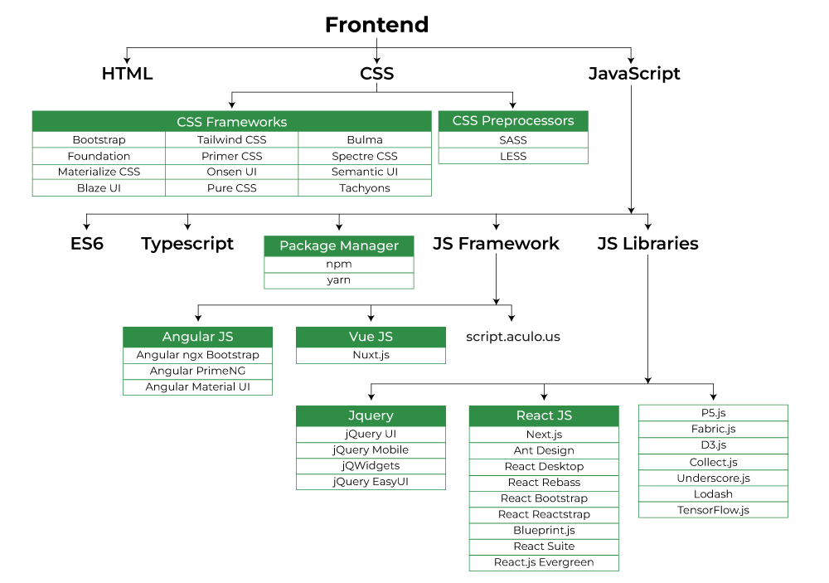
Ways of Web Development
Frontend Development
The part of a website that the user interacts directly is termed as front end. It is also referred to as the ‘client side’ of the application.

Slide 6
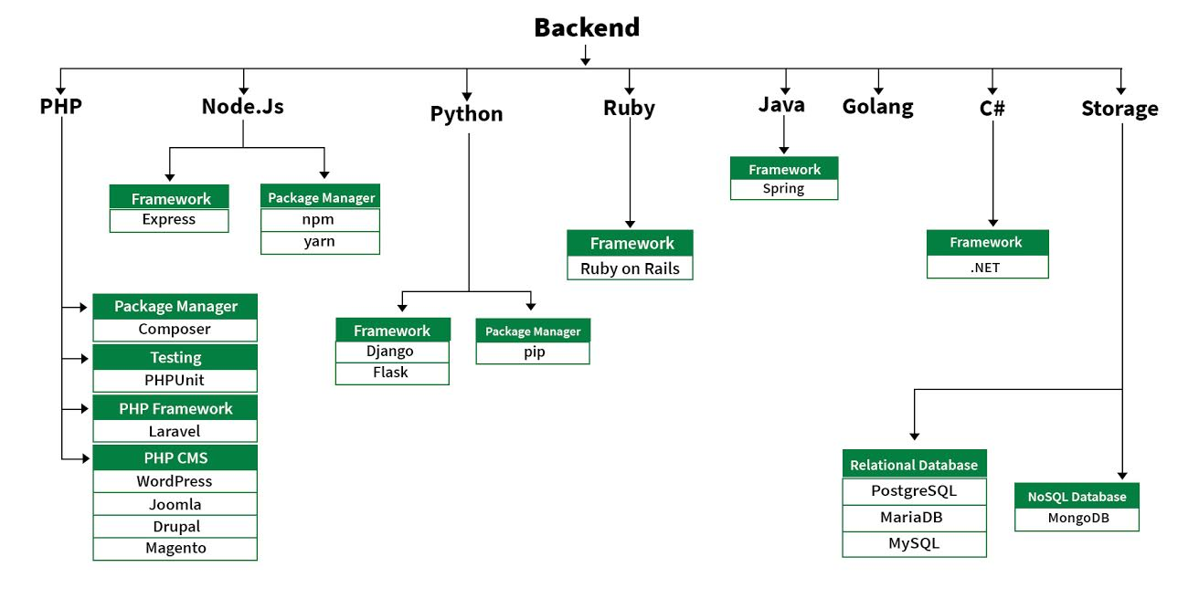
Ways of Web Development
Backend Development
Backend is the server side of a website. It is the part of the website that users cannot see and interact. It is the portion of software that does not come in direct contact with the users. It is used to store and arrange data.

Slide 7
Introduction to HTML

Slide 8
Introduction
HTML: Hyper-Text Markup Language
The Language of Web Pages on the World Wide Web
Web pages are also called HTML Documents.
It defines the structure of webpages and determines how data is displayed online.
HTML is a text formatting language.
A set of special instructions that can be added in the text to add formatting and linking information.
Directly interpreted(understand) by the browser.
HTML is specified as TAGS in an HTML document.

Slide 9
Cont…
Hypertext:
Allows linking of page to other documents/pages.
Markup Language:
Content is “marked up” or tagged to tell the browser how to display it.

Slide 10
History of HTML
HTML was created in 1991 by Tim Berners-Lee at CERN in Switzerland.
It was designed to allow scientists to display and share their research.
1995-HTML 2
Lots of browsers had added their own bits to HTML.
Dan Connolly and colleagues collected all the HTML tags that were widely used and collated them into a draft document.

Slide 11
Cont…
1997-HTML 3.2
It was the first version developed and standardized exclusively by the W3C
It included the support for applets, text flow around images, subscripts and superscripts etc.
1999 –HTML 4.1
Extends HTML with mechanisms for style sheets, scripting, frames etc.
2012-HTML5

Slide 12
Cont…
HTML is not case-sensitive
<tag> </tAg>
HTML files have .html or .htm extension

Slide 13
HTML Tags
Tags are instruction that are directly embedded into the text of the document.
Is a signal to a browser to do something before just throwing text on the screen. E.g. Effects etc.
Begin with open angle bracket < and ends with close angle bracket >
For example <HTML>
HTML tags can be of two types:
Paired Tags
Singular Tags

Slide 14
Cont…
Paired Tags:
A tag is said to be a paired tag if it, along with a companion tag, embeds the text.
<B> Hello World </B>
The first tag <B> is called opening tag and the second tag </B> is called closing tag.
Singular Tags:
Singular tag is also called stand-alone tag.
It does not have a companion tag.
For example, <BR> is a singular tag, and will insert a line break.

Slide 15
Cont…
Attributes:
Some HTML tags requires additional information to be supplied to them.
For instance, when a picture is placed on the screen information like the height and width of the picture can be specified.
Additional information supplied to HTML tag is known as Attributes of a tag.
Attributes are written immediately following the tag, separated by a space in start tag.
Attributes usually come in name/value pairs like: name="value"

Slide 16
Structure of HTML Page
The entire web page is enclosed within <HTML> and </HTML>
Within these tags two distinct sections are created head and body.

Slide 17
Cont…
Head:
Information is placed in this section is essential to the inner workings of the document and has nothing to do with the contents of the document.
All information placed within the <HEAD> </HEAD> tags is not displayed in the browser.
With the exception of the information contained within the <TITLE> </TITLE> tags.
<HEAD>
<TITLE> …… </TITLE>
</HEAD>

Slide 18
Cont…
Body:
The tags used to indicate the start and end of the main body or textual information are:
<BODY>
…..
</BODY>
Pages default like background color, text color, font size and so on can be specified as attributes of the <BODY> tag.

Slide 19
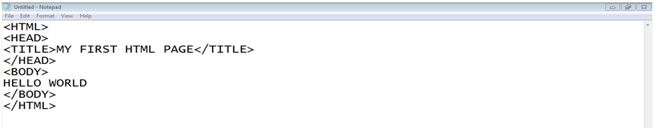
Example

Slide 20
The Body Tag
Attributes
BGCOLOR: Change the background color
BACKGROUND: Place an image at background
TEXT: Change the color of the body text
Example
<BODY BGCOLOR=123345 TEXT=Red>
<BODY BACKGROUND=“img.jpg” TEXT=Red>
<BODY BACKGROUND=“starfield.gif” TEXT=“red”>

Slide 21
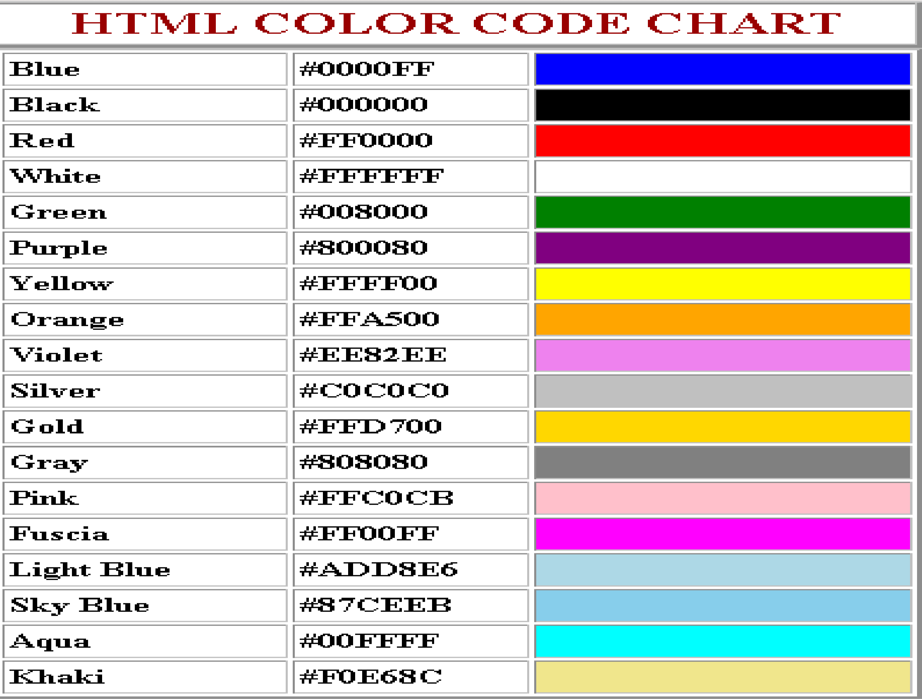
HTML Color code

Slide 22
Paragraphs in HTML
Paragraph Breaks:
A blank line always separate paragraphs in textual material.
The tag that provide this function is <P>…</P> .
The <p> tag defines a paragraph. Browsers automatically add a single blank line before and after each <p> element.
Example:
<P> A channel is a dedicated path for data to flow along. It doesn’t bother too much about error correction on its own. </P> <P> So a channel can be very fast.<P/>

Slide 23
Paragraphs in HTML
:
Paragraph Breaks:
The HTML <pre> element defines preformatted text.
The text inside a <pre> element is displayed in a fixed-width font (usually Courier), and it preserves both spaces and line breaks.
Example:
<pre> My Bonnie lies over the ocean. My Bonnie lies over the sea. My Bonnie lies over the ocean. Oh, bring back my Bonnie to me. </pre>

Slide 24
Cont…
Line Breaks
When text needs to start from a new line, the <BR> tag should be used.
This tag simply jumps to the start of the next line.
Example:
Software Technology Park, <BR> Service Road, I-9/3 <BR> Islamabad.
Output:
Software Technology Park,
Service Road, I-9/3
Islamabad.

Slide 25
Cont…
.
Horizontal Line
The <hr> tag defines a thematic break in an HTML page, and is most often displayed as a horizontal rule.
The <hr> tag is an empty tag, which means that it has no end tag.
Example:
<h1>This is heading 1</h1> <p>This is some text.</p> <hr> <h2>This is heading 2</h2> <p>This is some other text.</p> <hr>

Slide 26
Style Attribute
Setting the style of an HTML element, can be done with the style attribute.
The HTML style attribute has the following syntax:
<tagname style="property:value;">
The property is a CSS property. The value is a CSS value.
Back-ground Color
<body style="background-color:powderblue;"> <h1>This is a heading</h1> <p>This is a paragraph.</p> </body>
<body> <h1 style="background-color:powderblue;">This is a heading</h1> <p style="background-color:tomato;">This is a paragraph.</p> </body>

Slide 27
Cont…
Background Image:
<body style="background-image: url('img_girl.jpg');">
<p> This is paragraph </p>
</body>
<p style="background-image: url('img_girl.jpg');"> Welcome </p>
Text Color:
<h1 style="color:blue;">This is a heading</h1> <p style="color:red;">This is a paragraph.</p>
Font:
<h1 style="font-family:verdana;">This is a heading</h1> <p style="font-family:courier;">This is a paragraph.</p>

Slide 28
Cont…
Text Size:
<h1 style="font-size:300%;">This is a heading</h1> <p style="font-size:160%;">This is a paragraph.</p>
Text Alignment:
<h1 style="text-align:center;">Centered Heading</h1> <p style="text-align:center;">Centered paragraph.</p>

Slide 29
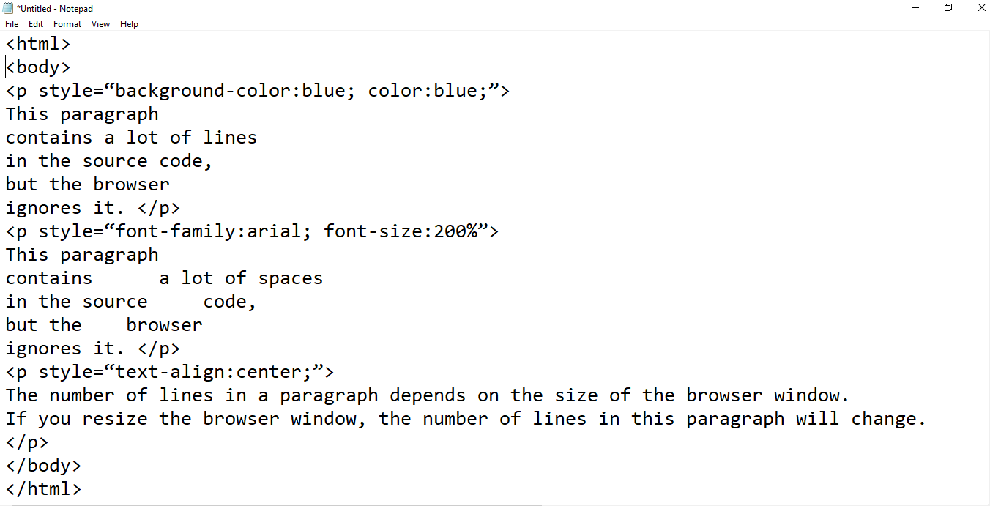
Example

Slide 30
Text Formatting tags in html
<b> defines the bold text </b>
<u> underline the text </u>
<i> change font of text into italic </i> or <em> </em>
<h1> defines the heading in body </h1>
Heading Level: H1(Highest) to H6(Least)
<small> defines the text in small </small>
<strong> defines the important text </strong>
<sub> defines the subscripted text </sub>
<sup> defines the superscripted text </sup>
<del> delete the text </del>
<ins> defines inserted text </ins>
<marquee direction=“right or left”> scrolling the text left-right & right-left </marquee>

Slide 31
Environment setting
Editors
Notepad
Notepad++
Sublime
Browser
Google Chrome
Internet Explorer
Mozilla
Firefox

Slide 32
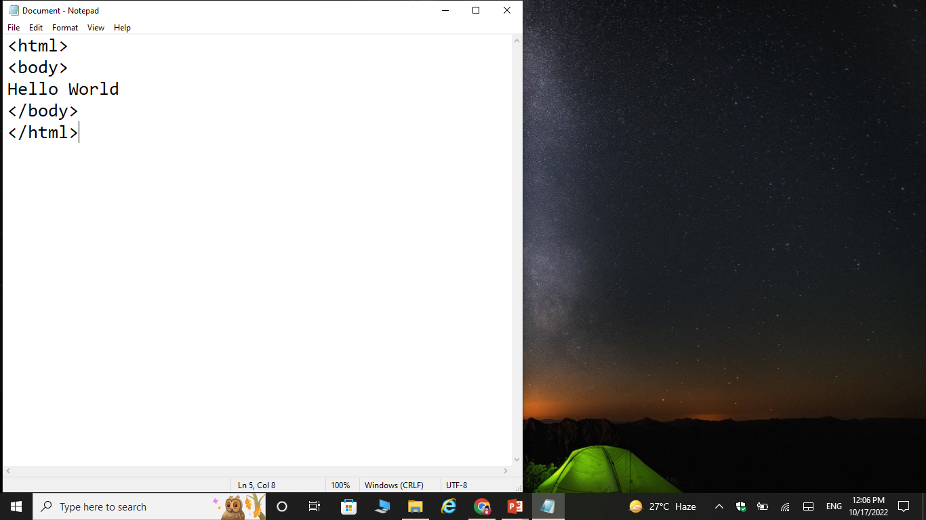
Steps for creating web page using html

Slide 33
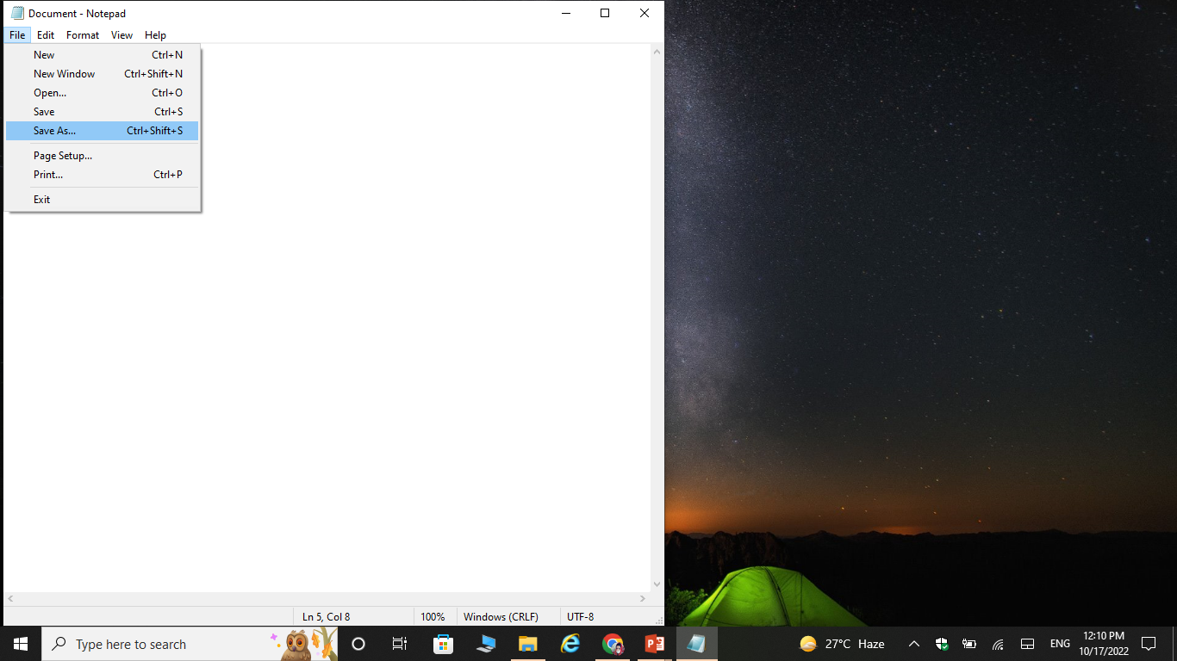
Cont…

Slide 34
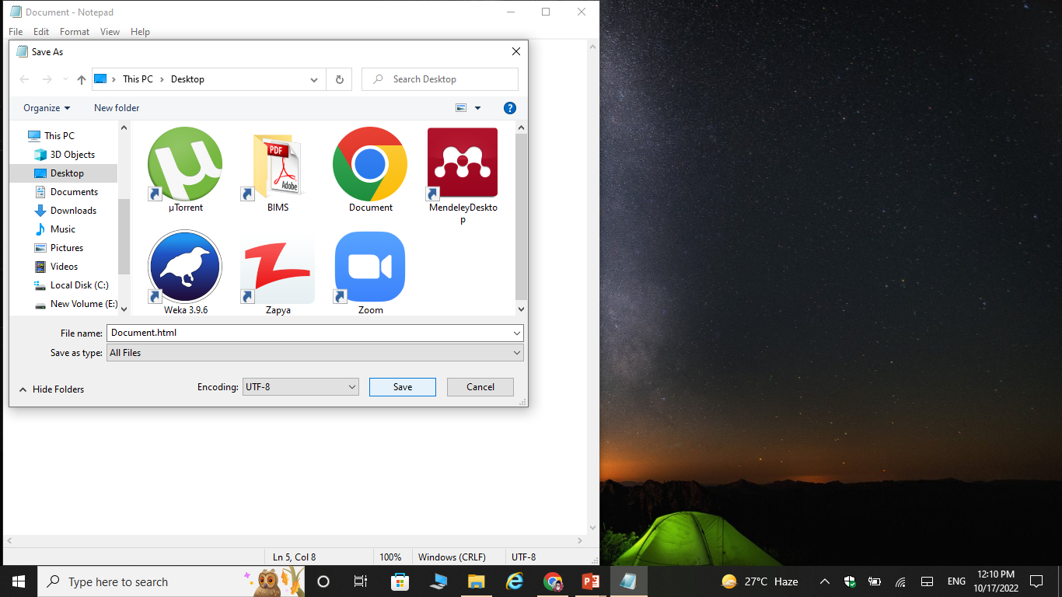
Cont…

Slide 35
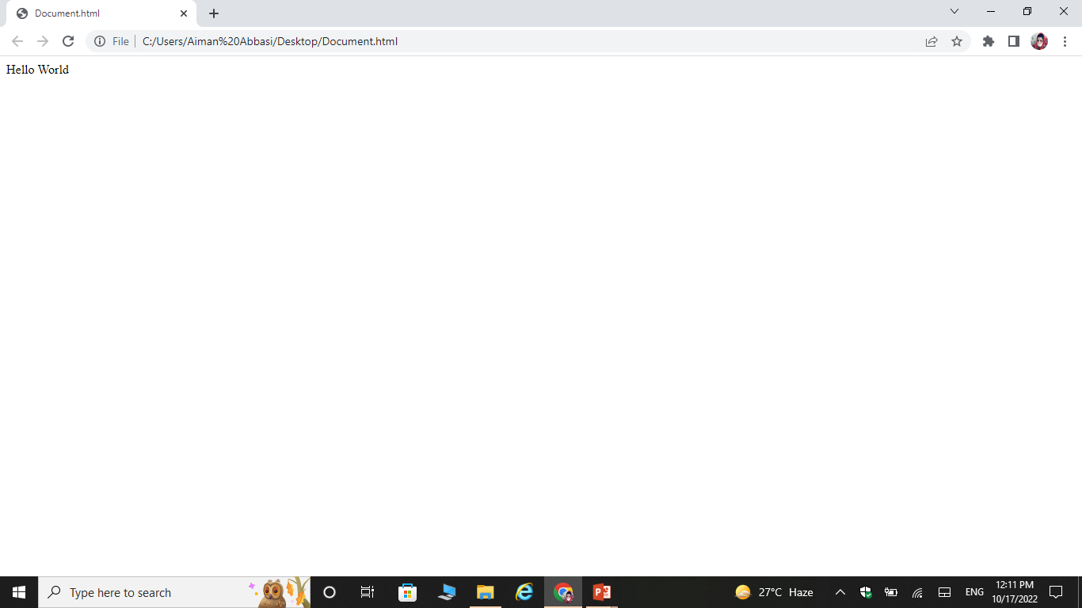
Cont…

Slide 36
Exercise Questions

Slide 37
Exercise Questions
How to add underline by using Text Styles.
How to display text in BOLD style.

